Slide 1
Introduction to Data Science

Slide 2
Cutting-edge training delivered by leading experts in the field of data analytics brought to you by the Business and Local Government Data Research Centre
Exploring data
Enhancing knowledge
Empowering society
Offering grant funded data analytics research projects, training, events, webinars and data consultation services.
To find out more please contact Laura.brookes@essex.ac.uk

Slide 3
Agenda
What is Data Science?
Regression
Classification
Cross-validation
Subset selection
Non-linear models
Tree-based methods

Slide 4
Introduction to the session
For the hands-on session visit the following web page: https://esrc-blg.github.io/ml101

Slide 5
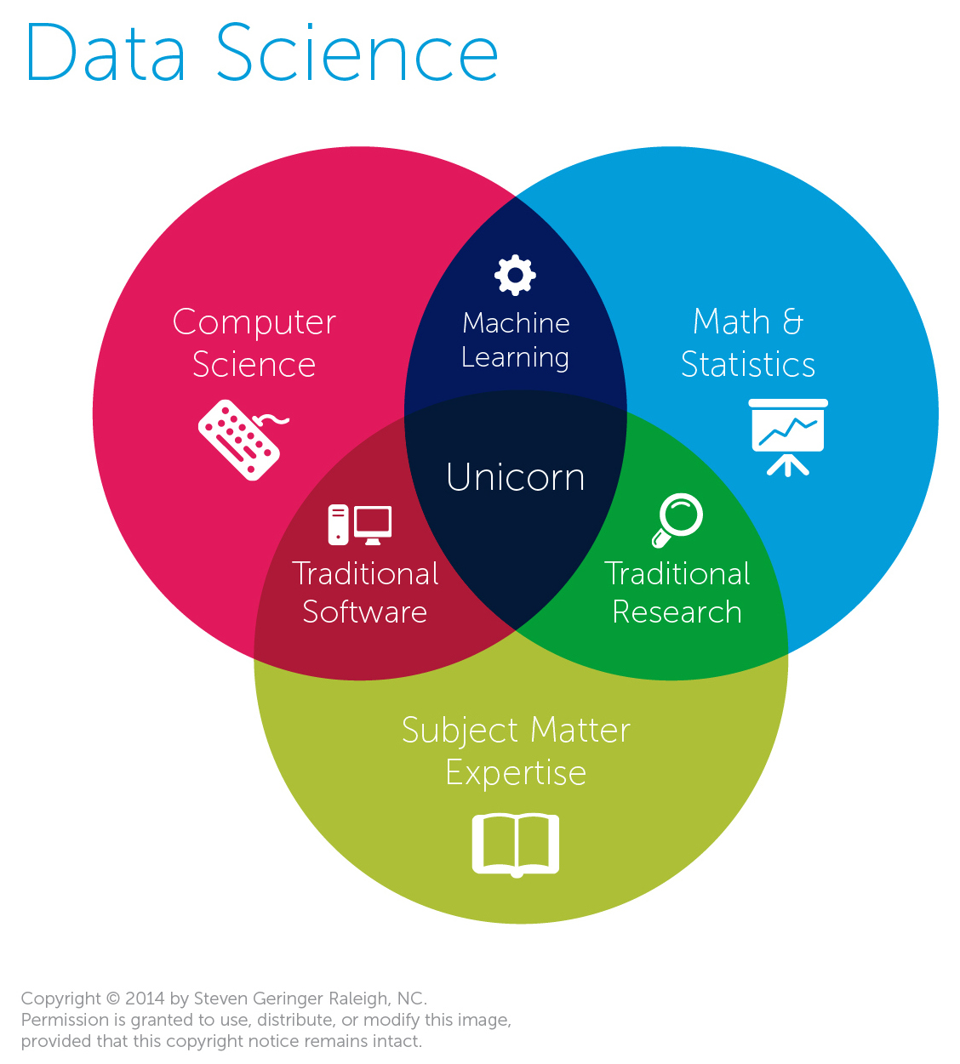

Slide 6
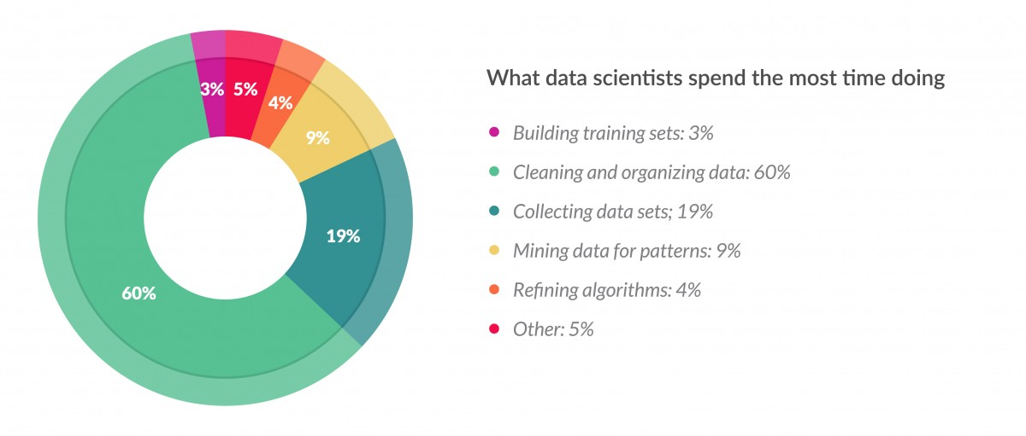
Reality
Source: https://www.forbes.com/sites/gilpress/2016/03/23/data-preparation-most-time-consuming-least-enjoyable-data-science-task-survey-says/#4a79a76c7f75

Slide 7
Machine/Statistical Learning Problems
Prediction: E.g. heart attacks on the basis of demographic and clinical data
Prediction: Classify an email into: spam – not spam
Prediction: Identify the numbers in handwritten post code
Prediction: Identify the best model to predict turnout and vote choice
Prediction: Find the best predictors for income among demographic variables in a survey
But causality is coming back in current ML research

Slide 8
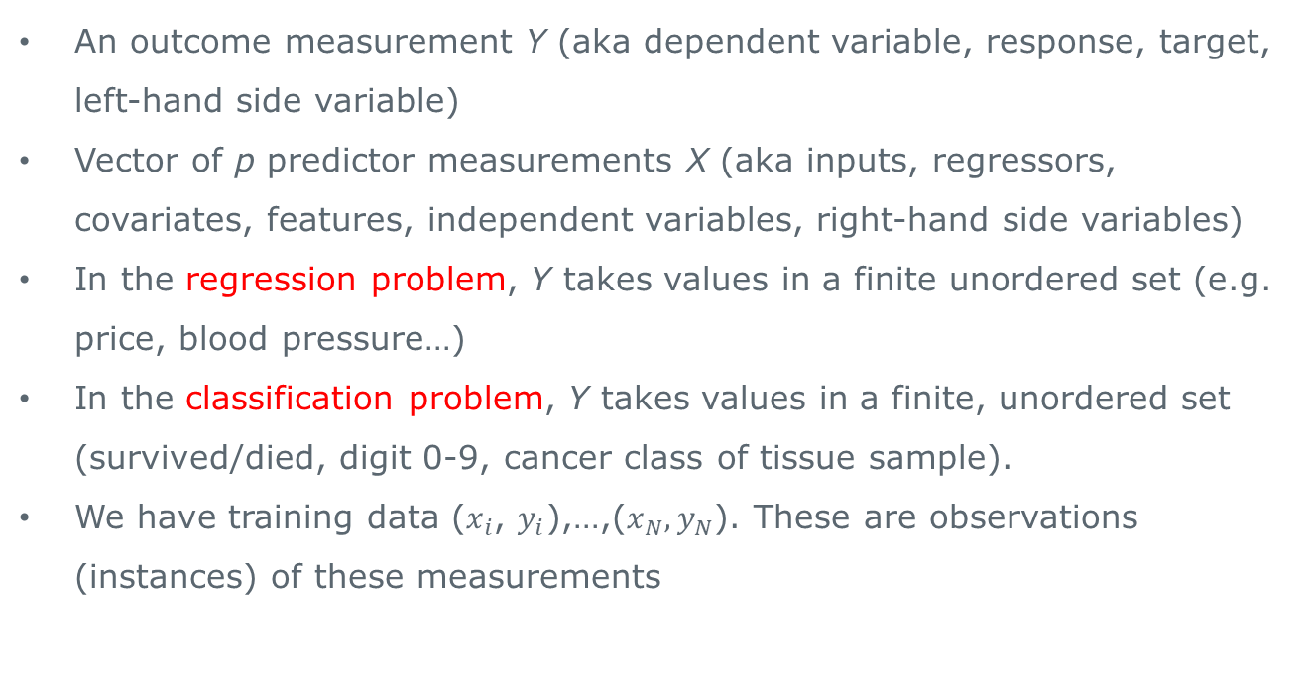
Supervised Learning (Outcome is known)
An outcome measurement Y (aka dependent variable, response, target, left-hand side variable)
Vector of p predictor measurements X (aka inputs, regressors, covariates, features, independent variables, right-hand side variables)
In the regression problem, Y takes values in a finite unordered set (e.g. price, blood pressure…)
In the classification problem, Y takes values in a finite, unordered set (survived/died, digit 0-9, cancer class of tissue sample).
We have training data ($x_{i}$, $y_{i}$),…,($x_{N}, y_{N}$). These are observations (instances) of these measurements

Slide 9
Objectives of supervised learning
On the basis of the training data we would like to:
sad
df
Accurately predict unseen test cases
Understand which inputs affect the outcome, and how (although here we are straying into the territory of causal inference)
Assess the quality of our predictions and inferences

Slide 10
Unsupervised learning (no outcome measurement)
No outcome variable, just a set of predictors (features) measured on a set of samples
Find groups or clusters, were observations are similar within groups but differences across groups are large
Difficult to assess quality
Sometimes used as a pre-processing step for supervised learning
Often used when working with textual data, e.g. to uncover topics in legislative speech

Slide 11
Philosophy
It is important to understand the ideas behind various techniques, in order to know how and when to use them
We need to understand the simpler methods first, in order to grasp the more sophisticated ones
It is important to be able to accurately assess the performance of a method (simpler methods are often competitive and there is no one best method for all problems)
If you are interested in learning whether a specific intervention has its intended effect, you need a causal inference class

Slide 12
The Netflix prize
Competition started in Oct 2006. Training data is ratings for 18,000 moves by 400,000 Netflix customers and each rating is between 1 (worst) and 5 (best)
Training data is very sparse – about 98% missing
Objective: Predict the rating for a set of 1 million customer-movie pairs that are missing in the training data.
Netflix’s original algorithm achieved a root MSE of 0.953. The first team to achieve a 10% improvement wins $1,000,000
Is this a supervised or an unsupervised problem?

Slide 13
Statistical learning v. machine learning
Machine learning arose as a subfield of artificial intelligence
Statistical learning arose as a subfield of statistics
Much overlap – both fields focus on supervised and unsupervised problems:
Machine learning has a greater emphasis on large scale applications and prediction accuracy
Statistical learning emphasises models and their interpretability, precision and uncertainty
Over time, the differences became less and less pronounced and machine learning has emerged as the general label

Slide 14
Prediction v. explaining relationships
A causal inference problem is where we want to learn about the effect that X exerts on Y
E.g.: Do stop and searches reduce knife crime?
A prediction problem is where we want to predict an outcome as accurately as possible
E.g.: Does a patient have cancer or not?
In a prediction problem, we do not necessarily need to establish causal relationships. However a truly causal model with always be a good predictive model (e.g. in weather forecasts all error comes from inaccurate measurement)

Slide 15
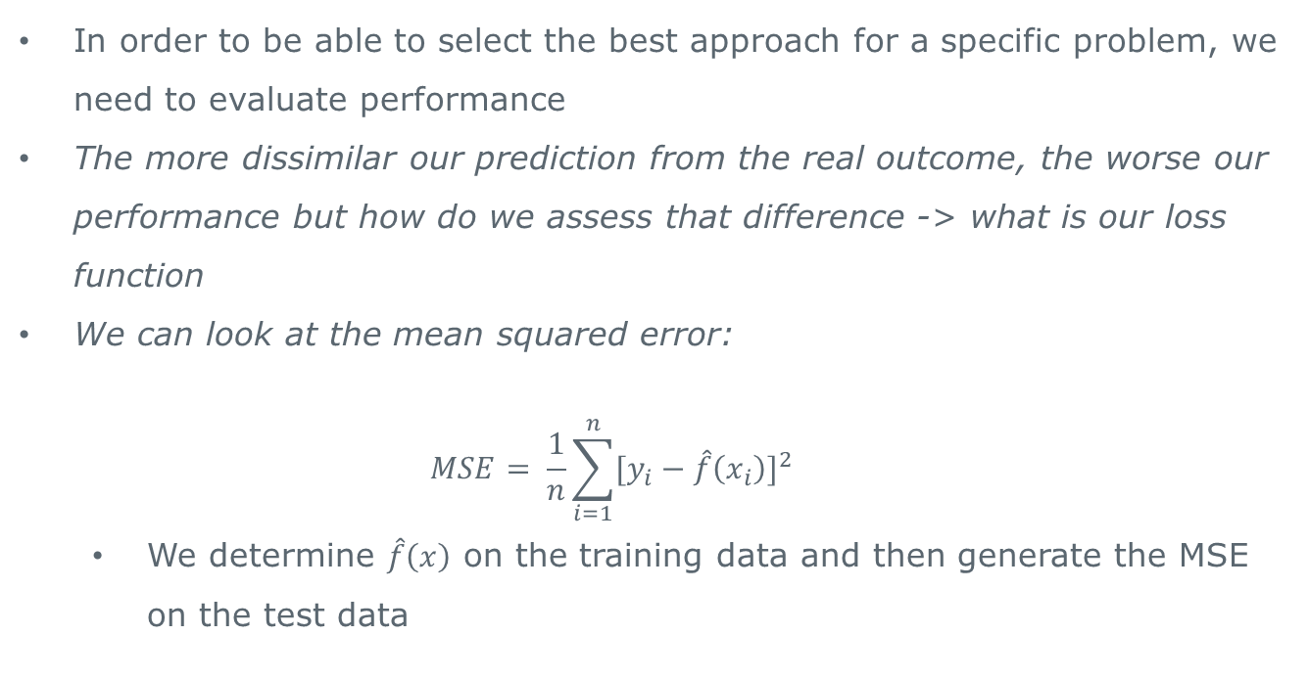
Assessing model accuracy
In order to be able to select the best approach for a specific problem, we need to evaluate performance
The more dissimilar our prediction from the real outcome, the worse our performance but how do we assess that difference -> what is our loss function
We can look at the mean squared error:
$$MSE= \frac{1}{n}\sum_{i=1}^{n}{[y_{i}−\hat{f}\left(x_{i}\right)]^{2}}$$
We determine $\hat{f}\left(x\right)$ on the training data and then generate the MSE on the test data

Slide 16
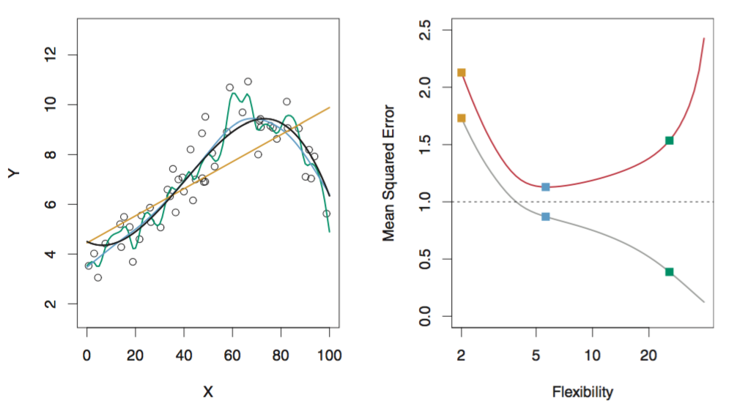
Variance-Bias Tradeoff 1
If we choose models based on training MSE, we end up with bad predictions
The problem is known as over-fitting:
James et al. 2013: 22-24

Slide 17
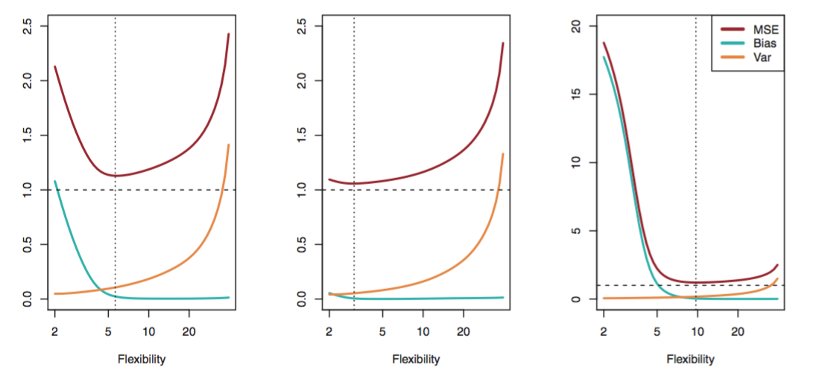
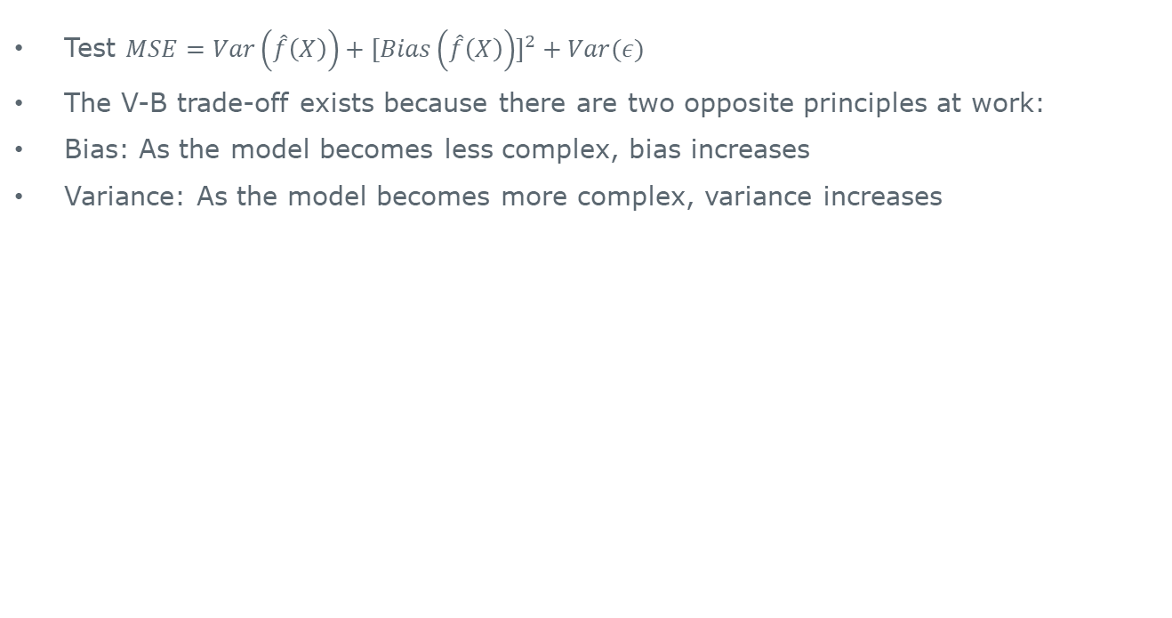
Variance-Bias Tradeoff 2
Test $MSE=Var\left(\hat{f}\left(X\right)\right)+[Bias\left(\hat{f}\left(X\right)\right)]^{2}+Var(ε)$
The V-B trade-off exists because there are two opposite principles at work:
Bias: As the model becomes less complex, bias increases
Variance: As the model becomes more complex, variance increases
James et al. 2013: 36

Slide 18
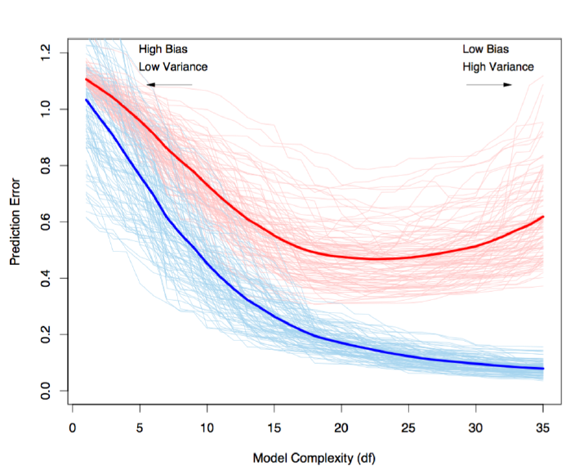
Variance-Bias Tradeoff 3
Red = test error;
blue = training error
Hastie et al. 2008: 220

Slide 19
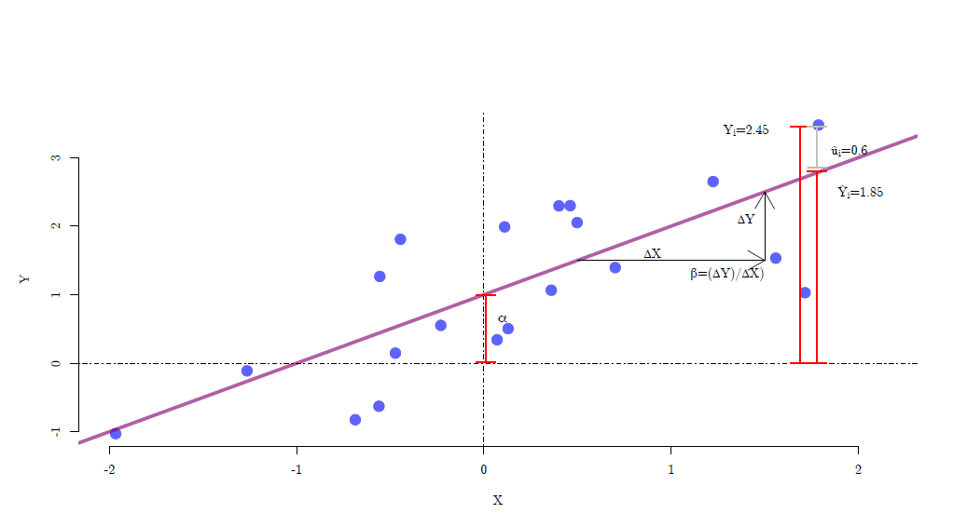
Linear models

Slide 20
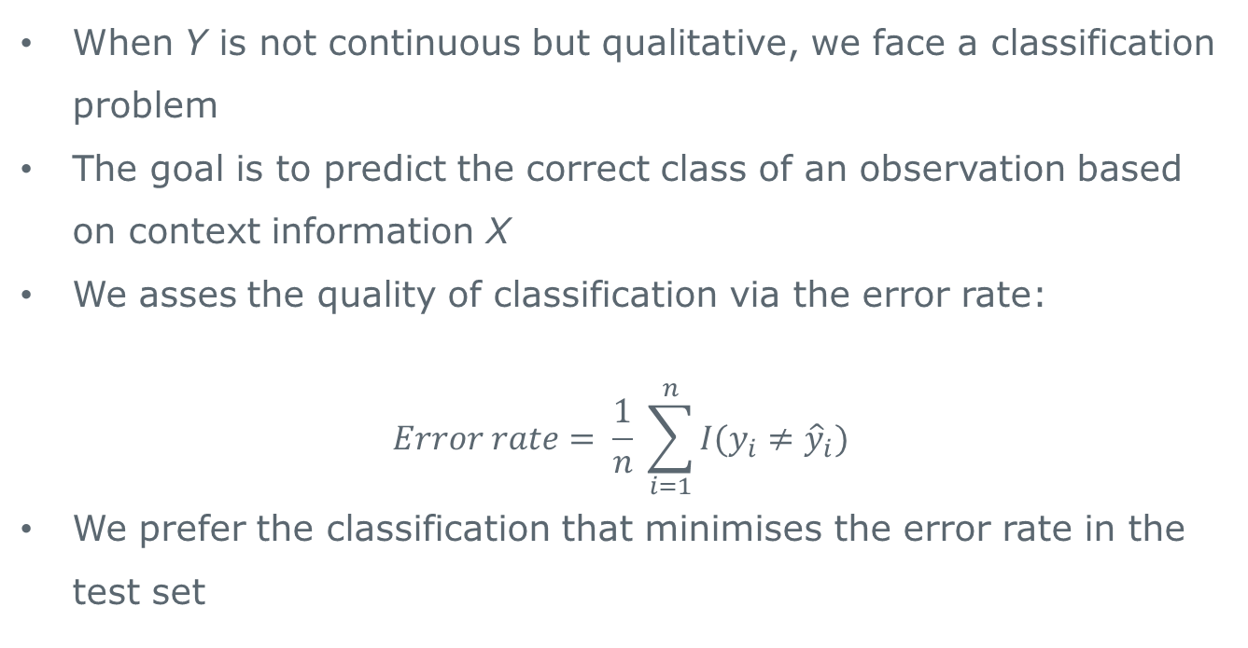
Classification
When Y is not continuous but qualitative, we face a classification problem
The goal is to predict the correct class of an observation based on context information X
We asses the quality of classification via the error rate:
$$Error rate= \frac{1}{n} \sum_{i=1}^{n}{I(y_{i}≠{\hat{y}}_{i})}$$
We prefer the classification that minimises the error rate in the test set

Slide 21
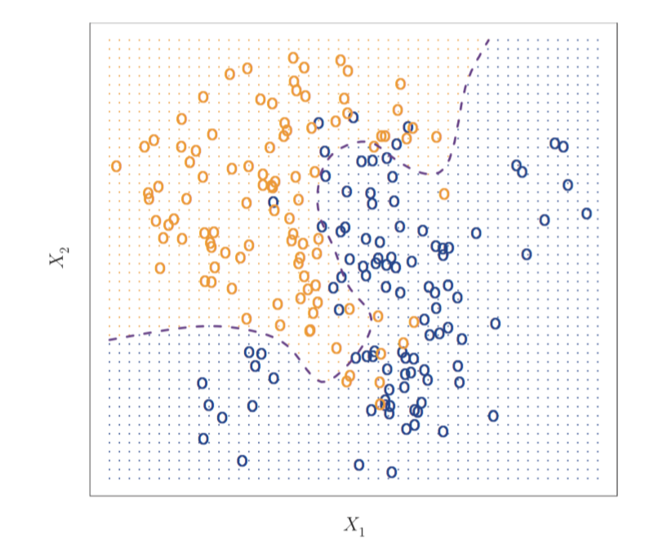
Classification
James et al. 2013: 38

Slide 22
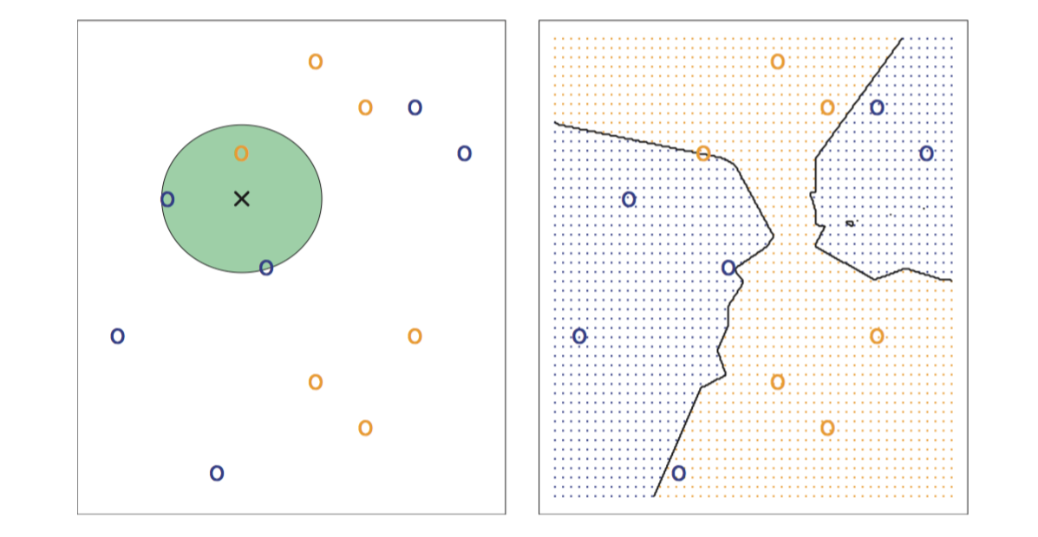
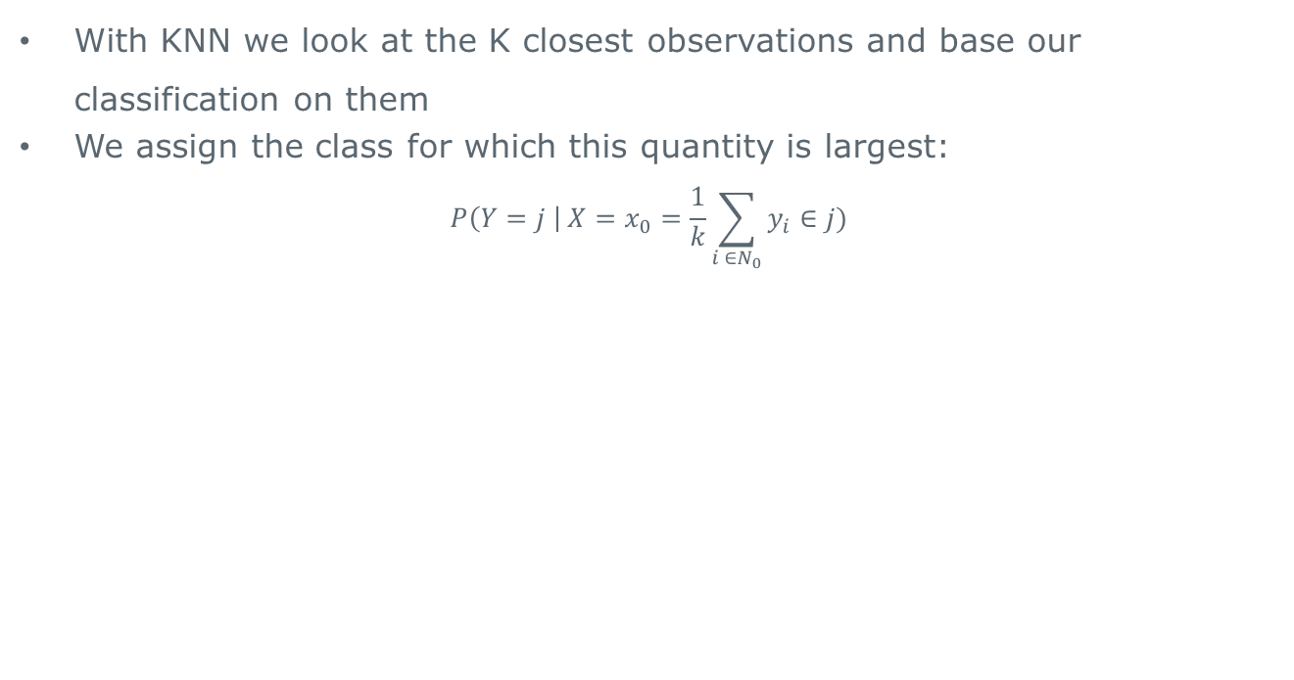
Classification with K Nearest Neighbor (KNN)
With KNN we look at the K closest observations and base our classification on them
We assign the class for which this quantity is largest:
$$P\left(Y=j \right| X=x_{0}=\frac{1}{k}\sum_{i ∈N_{0}}{y_{i}∈j})$$
James et al. 2013: 40

Slide 23
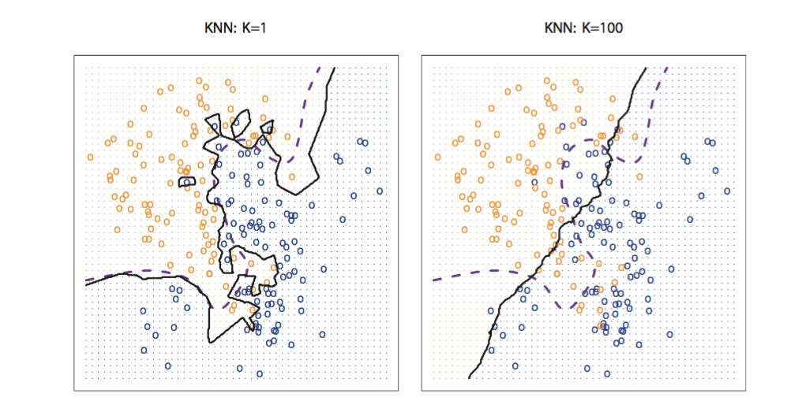
Classification with KNN 2
The choice of K matters:
James et al. 2013: 41

Slide 24
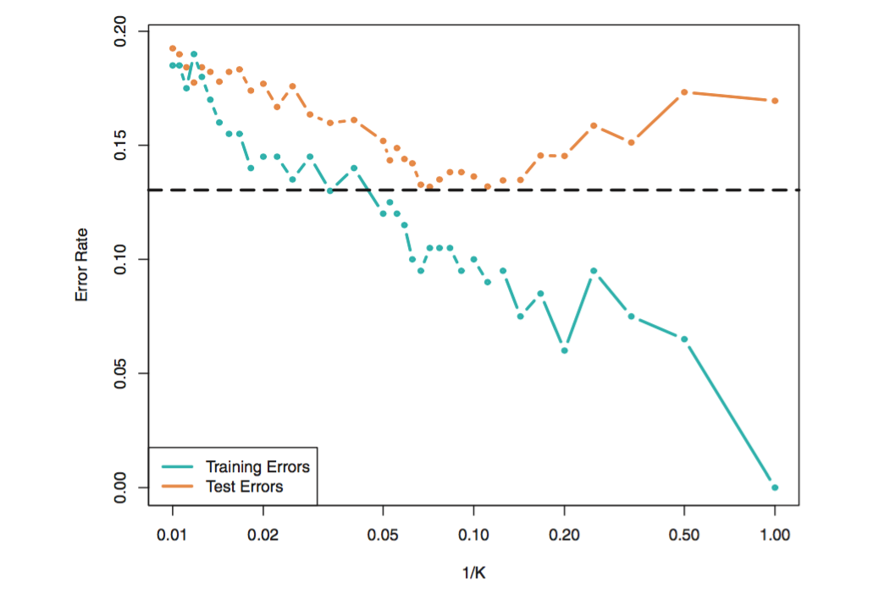
KNN and the variance-bias tradeoff
James et al. 2013: 42

Slide 25
Cross-validation
Without having new data, we can split the data we have into training and test data – this called re-sampling
Re-sampling is computationally expensive
Cross-validation methods:
Validation set approach
Leave-one-out cross-validation (LOOCV)
k-fold cross-validation
James et al. 2013: 42

Slide 26
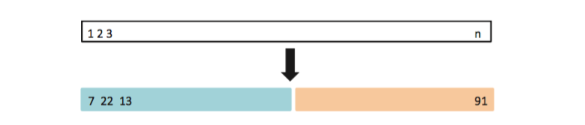
Validation set approach
Step 1: Split data in training and test sets at random
Step 2: Pick the optimal model in the training set
Step 3: Determine its performance on the test set
James et al. 2013: 177

Slide 27
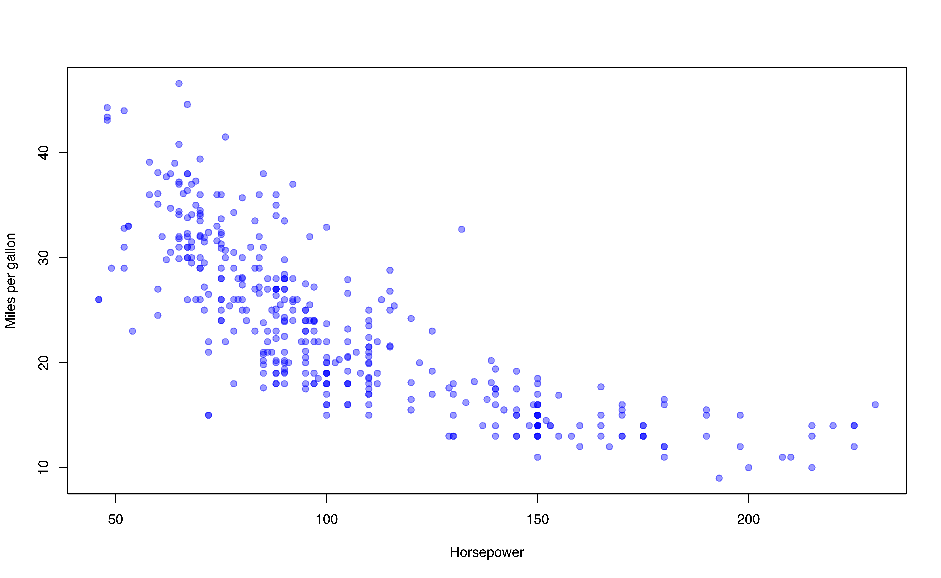
Auto Example (James et al., chapter 3)
Predict mpg with horsepower. But: How complex is the relationship?

Slide 28
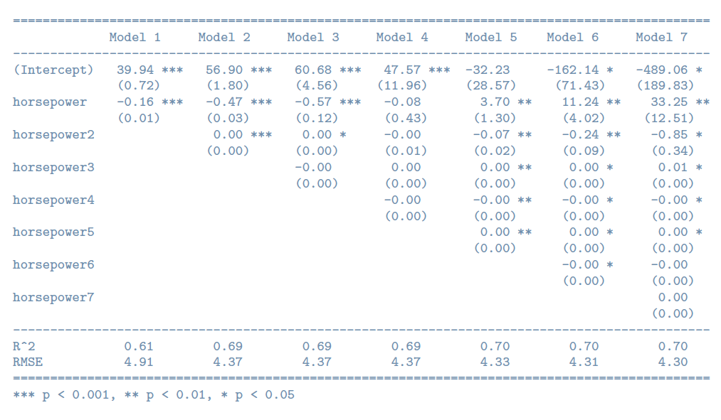
How many polynomials should we use?

Slide 29
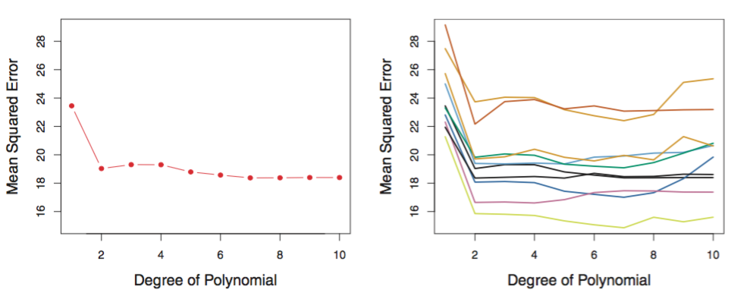
Validation set approach applied to Auto data
Validation approach: highly variable results (right plot)
Validation approach may tend to over-estimate test error due to small size of the training data
James et al. 2013: 178

Slide 30
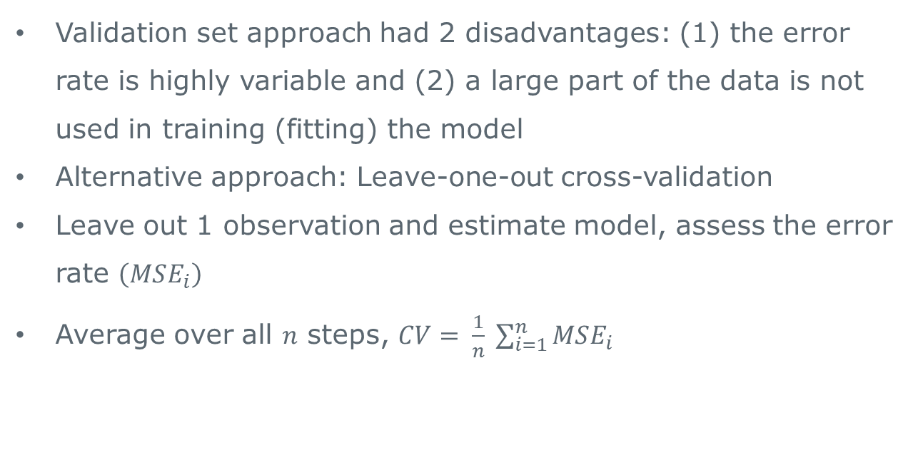
LOOCV
Validation set approach had 2 disadvantages: (1) the error rate is highly variable and (2) a large part of the data is not used in training (fitting) the model
Alternative approach: Leave-one-out cross-validation
Leave out 1 observation and estimate model, assess the error rate $\left(MSE_{i}\right)$
Average over all $n$ steps, $CV= \frac{1}{n} \sum_{i=1}^{n}{MSE_{i}}$

Slide 31
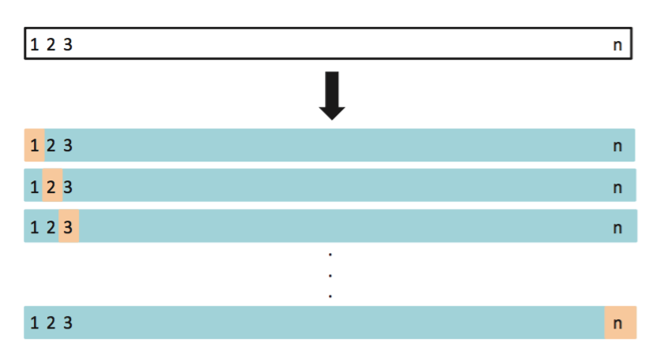
LOOCV 2
James et al. 2013: 179

Slide 32
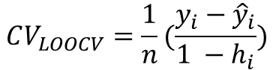
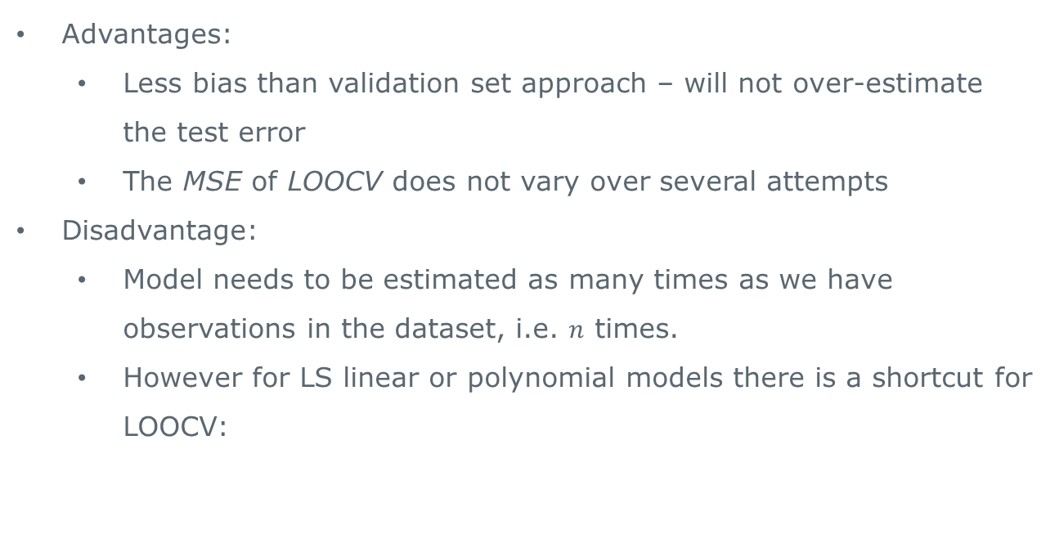
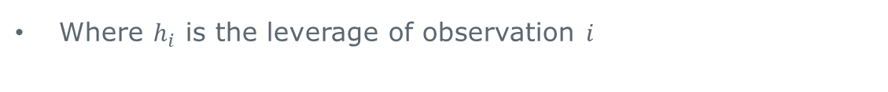
LOOCV 3
Advantages:
Less bias than validation set approach – will not over-estimate the test error
The MSE of LOOCV does not vary over several attempts
Disadvantage:
Model needs to be estimated as many times as we have observations in the dataset, i.e. $n$ times.
However for LS linear or polynomial models there is a shortcut for LOOCV:
$$CV_{LOOCV}=\frac{1}{n}(\frac{y_{i}−{\hat{y}}_{i}}{1 −h_{i}})$$
Where $h_{i}$ is the leverage of observation $i$

Slide 33
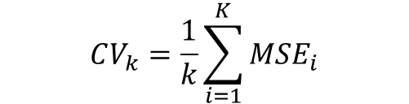
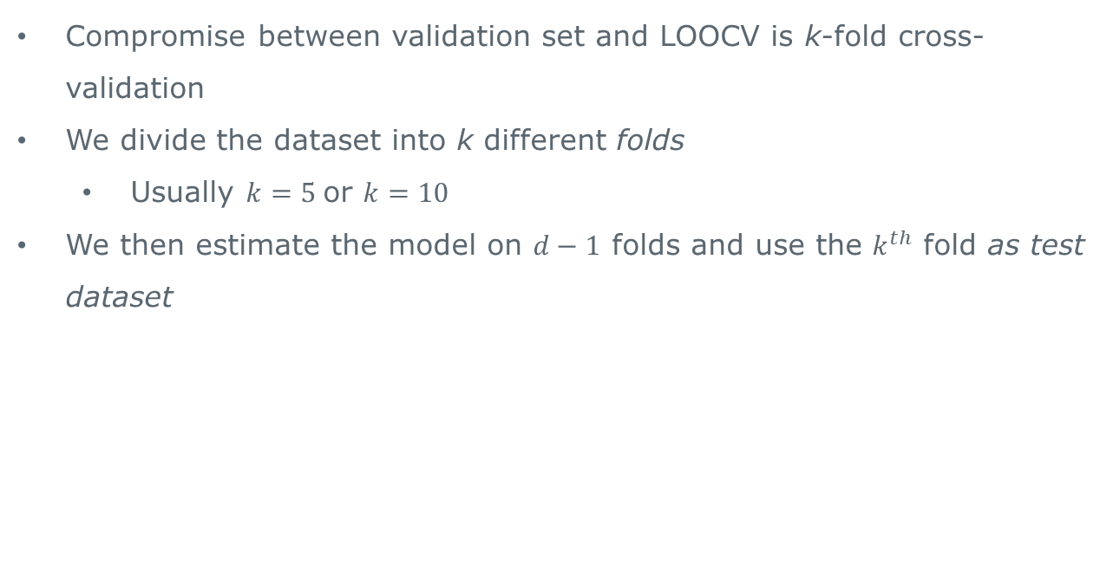
k-fold cross-validation
Compromise between validation set and LOOCV is k-fold cross-validation
We divide the dataset into k different folds
Usually $k=5$or $k=10$
We then estimate the model on $d−1$ folds and use the $k^{th}$ fold as test dataset
$$CV_{k}=\frac{1}{k}\sum_{i=1}^{K}{MSE_{i}}$$

Slide 34
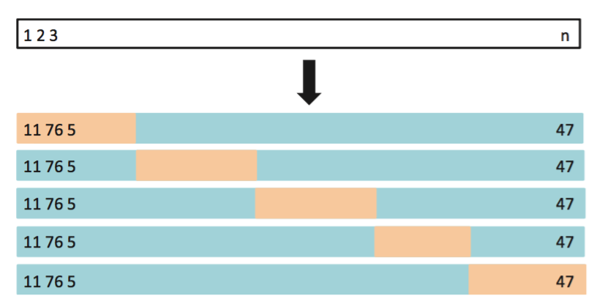
k-fold cross-validation

Slide 35
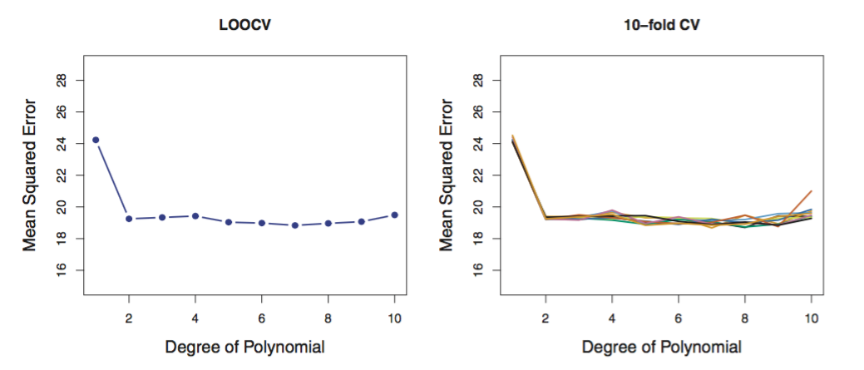
k-fold cross-validation v. LOOCV
Similar error rates, but 10-fold CV is much faster
James et al. 2013: 180

Slide 36
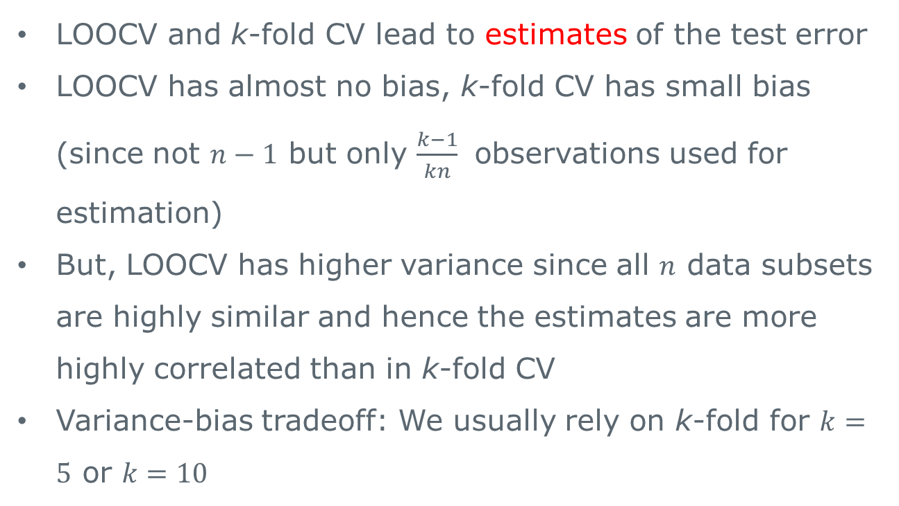
Variance-bias tradeoff
LOOCV and k-fold CV lead to estimates of the test error
LOOCV has almost no bias, k-fold CV has small bias (since not $n−1$ but only $\frac{k−1}{kn}$ observations used for estimation)
But, LOOCV has higher variance since all $n$ data subsets are highly similar and hence the estimates are more highly correlated than in k-fold CV
Variance-bias tradeoff: We usually rely on k-fold for $k=5$ or $k=10$

Slide 37
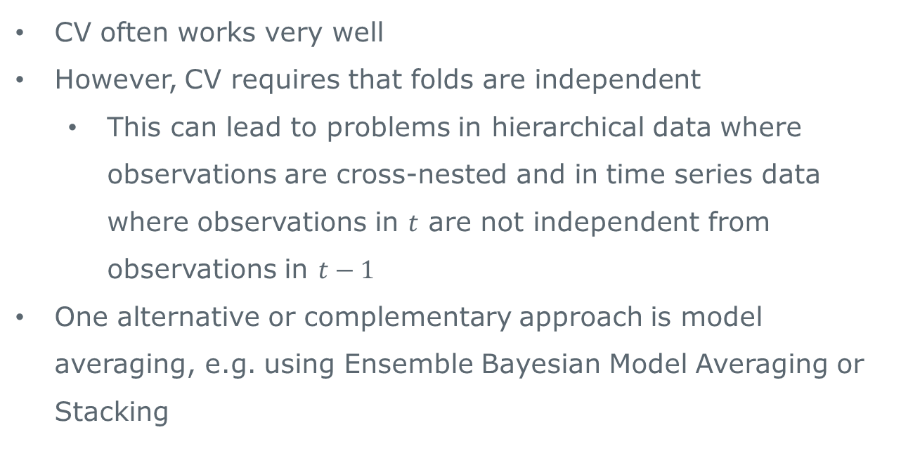
CV the solution to all our problems?
CV often works very well
However, CV requires that folds are independent
This can lead to problems in hierarchical data where observations are cross-nested and in time series data where observations in $t$ are not independent from observations in $t−1$
One alternative or complementary approach is model averaging, e.g. using Ensemble Bayesian Model Averaging or Stacking

Slide 38
Regularization
Ridge Regression & Lasso
We fit a model on all p predictors using a technique that constrains or regularizes the coefficient estimates, or equivalently, that shrinks coefficient estimates towards 0
It is an empirical finding, that shrinking coefficient estimates can significantly reduce variance

Slide 39
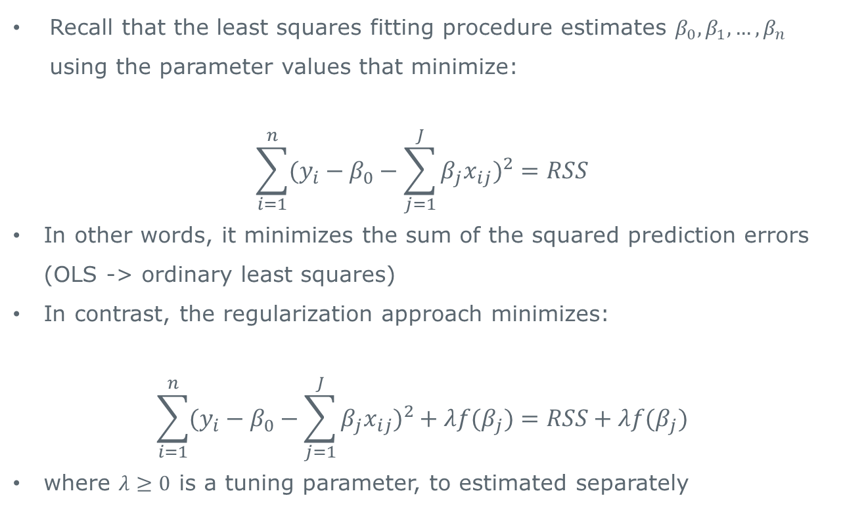
Regularization
Recall that the least squares fitting procedure estimates $β_{0}, β_{1},…,β_{n}$ using the parameter values that minimize:
$$\sum_{i=1}^{n}{(y_{i}−β_{0}−\sum_{j=1}^{J}{β_{j}x_{ij}})^{2}=RSS}$$
In other words, it minimizes the sum of the squared prediction errors (OLS -> ordinary least squares)
In contrast, the regularization approach minimizes:
$$\sum_{i=1}^{n}{(y_{i}−β_{0}−\sum_{j=1}^{J}{β_{j}x_{ij}})^{2}+λf(β_{j})=RSS+λf(β_{j})}$$
where $λ≥0$ is a tuning parameter, to estimated separately

Slide 40
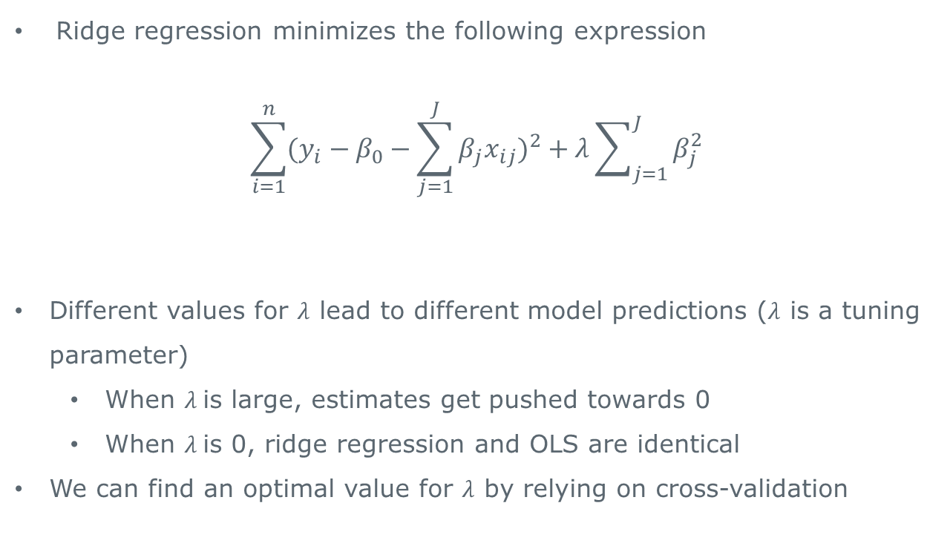
Ridge regression
Ridge regression minimizes the following expression
$$\sum_{i=1}^{n}{(y_{i}−β_{0}−\sum_{j=1}^{J}{β_{j}x_{ij}})^{2}+λ\sum_{j=1}^{J}{β_{j}^{2}}}$$
Different values for $λ$ lead to different model predictions ($λ$ is a tuning parameter)
When $λ$is large, estimates get pushed towards 0
When $λ$is 0, ridge regression and OLS are identical
We can find an optimal value for $λ$ by relying on cross-validation
Standard OLS estimate
penalty

Slide 41
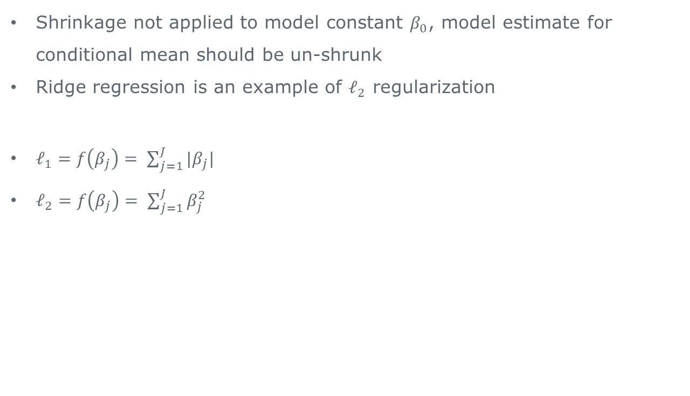
Ridge regression
Shrinkage not applied to model constant $β_{0}$, model estimate for conditional mean should be un-shrunk
Ridge regression is an example of $ℓ_{2}$ regularization
$ℓ_{1}=f\left(β_{j}\right)= \sum_{j=1}^{J}{{|β}_{j}|}$
$ℓ_{2}=f\left(β_{j}\right)= \sum_{j=1}^{J}{β_{j}^{2}}$

Slide 42
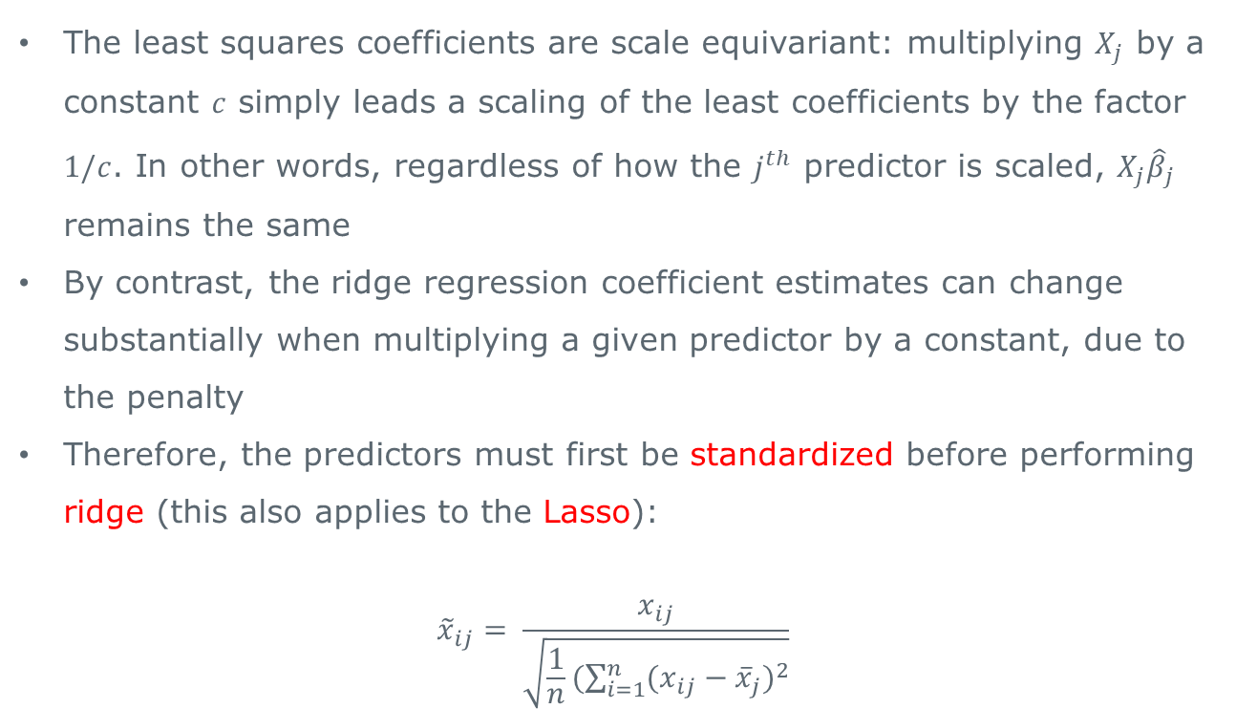
Ridge regression
The least squares coefficients are scale equivariant: multiplying $X_{j}$ by a constant $c$ simply leads a scaling of the least coefficients by the factor $1/c$. In other words, regardless of how the $j^{th}$ predictor is scaled, $X_{j}{\hat{β}}_{j}$ remains the same
By contrast, the ridge regression coefficient estimates can change substantially when multiplying a given predictor by a constant, due to the penalty
Therefore, the predictors must first be standardized before performing ridge (this also applies to the Lasso):
$${\tilde{x}}_{ij}= \frac{x_{ij}}{\sqrt{\frac{1}{n}(\sum_{i=1}^{n}{(x_{ij}−{\overline{x}}_{j})^{2}}}}$$

Slide 43
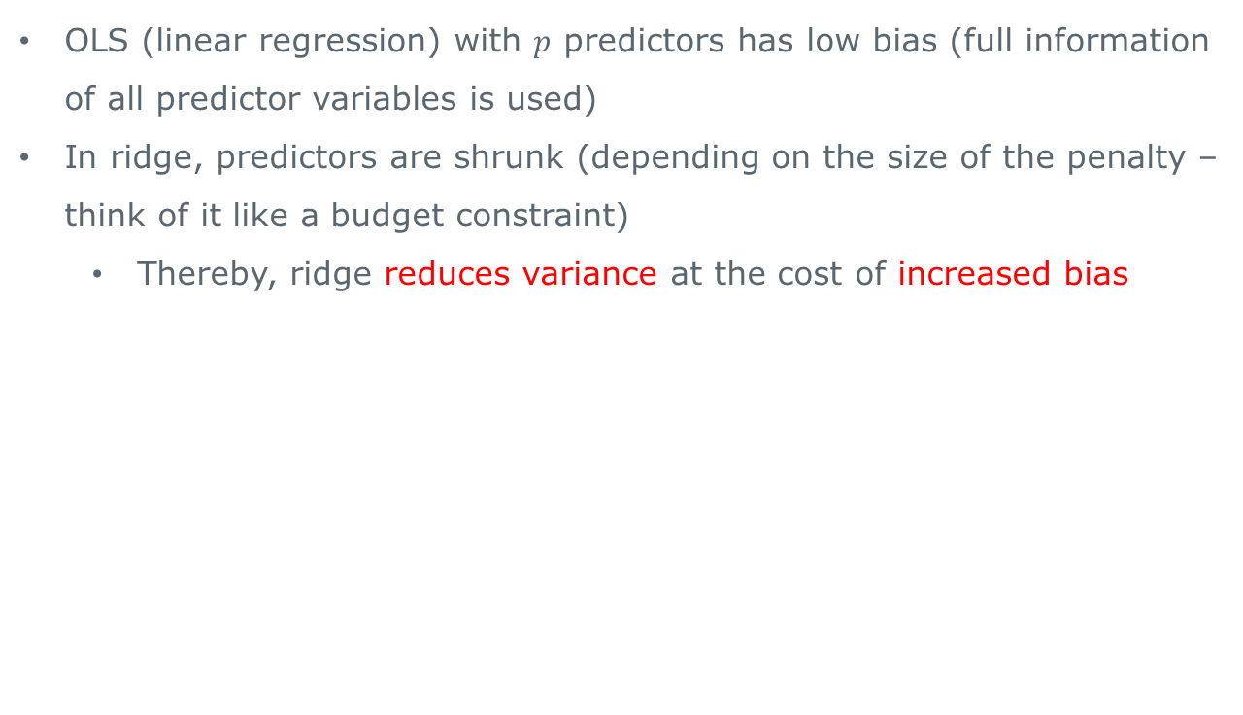
Ridge regression
OLS (linear regression) with $p$ predictors has low bias (full information of all predictor variables is used)
In ridge, predictors are shrunk (depending on the size of the penalty – think of it like a budget constraint)
Thereby, ridge reduces variance at the cost of increased bias

Slide 44
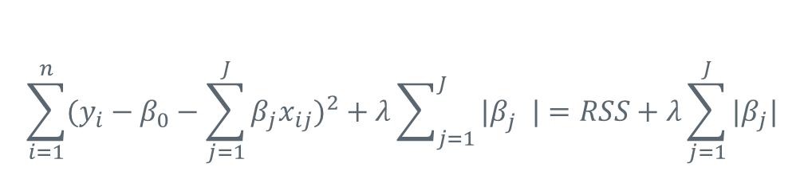
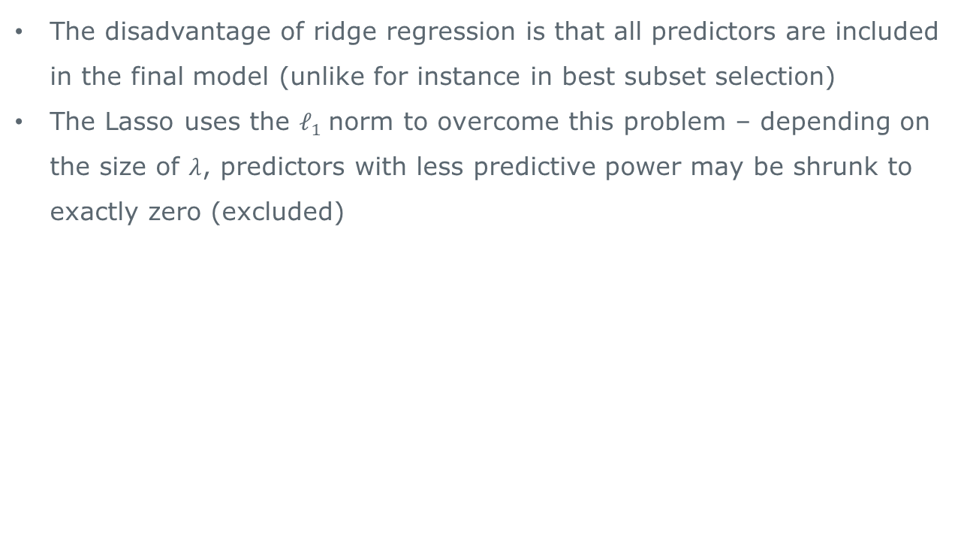
The Lasso
The disadvantage of ridge regression is that all predictors are included in the final model (unlike for instance in best subset selection)
The Lasso uses the $ℓ_{1}$norm to overcome this problem – depending on the size of $λ$, predictors with less predictive power may be shrunk to exactly zero (excluded)
$$\sum_{i=1}^{n}{(y_{i}−β_{0}−\sum_{j=1}^{J}{β_{j}x_{ij}})^{2}+λ\sum_{j=1}^{J}{{|β}_{j}^{}|}}=RSS+λ\sum_{j=1}^{J}{|β_{j}|}$$

Slide 45
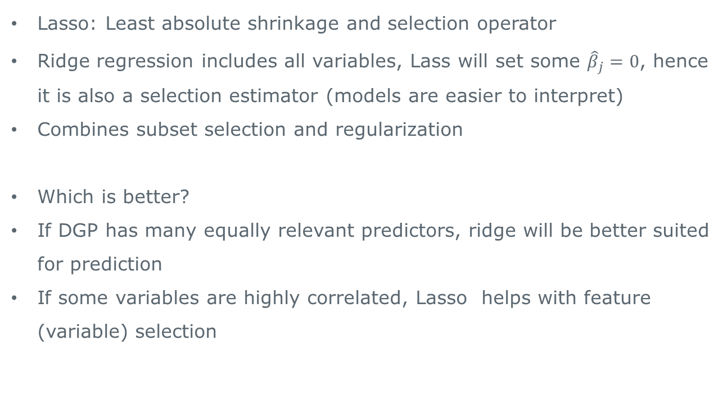
Lasso v Ridge
Lasso: Least absolute shrinkage and selection operator
Ridge regression includes all variables, Lass will set some ${\hat{β}}_{j}=0$, hence it is also a selection estimator (models are easier to interpret)
Combines subset selection and regularization
Which is better?
If DGP has many equally relevant predictors, ridge will be better suited for prediction
If some variables are highly correlated, Lasso helps with feature (variable) selection

Slide 46
Tree based models
Trees
Bagging/Random forests
Boosting

Slide 47
Tree-based methods
We stratify or segment the predictor space into a number of regions
Since a set of splitting rules used to segment the predictor space can be summarised in a tree, these types of approaches are also known as decision-tree methods

Slide 48
Pros and Cons
Tree-based methods are simple and useful for interpretation
However, they typically are not competitive with the best supervised learning approaches in terms of prediction accuracy
Extensions such as bagging, random forests and boosting are very competitive. These methods grow multiple trees (ensembles) which are then combined to yield a single consensus prediction
Combining a large number of trees can often result in dramatic improvements in prediction accuracy, at the expense of some loss in ease of interpretation

Slide 49
The basics of decision trees
Decision trees can be applied to both regression and classification problems
We first consider regression and then move to classification

Slide 50
Baseball salary data
We predict hitters logged salary based on the number of years played in major leagues and number of hits in previous year
At a tree’s node a condition is defined (e.g. Years < 4.5). At the left branch the condition is fulfilled and at the right branch the condition is not fulfilled
The following tree has 3 terminal nodes or leaves and the number in each leaf is the mean of the response for the observations that fall there

Slide 51
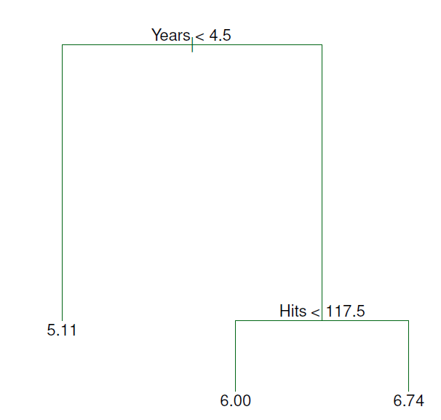
Baseball salary data
James et al. 2013: 304

Slide 52
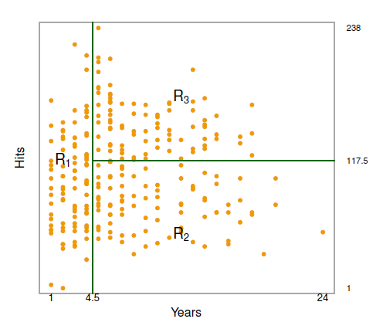
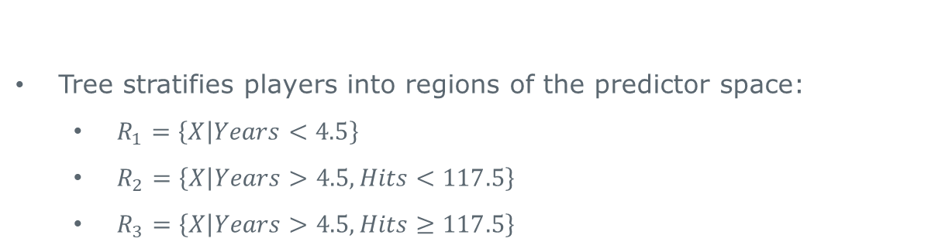
Results
Tree stratifies players into regions of the predictor space:
$R_{1}=\left\{X | Years<4.5\right\}$
$R_{2}=\left\{X | Years>4.5, Hits<117.5\right\}$
$R_{3}=\left\{X | Years>4.5, Hits≥117.5\right\}$
Hastie et al. 2008: 305

Slide 53
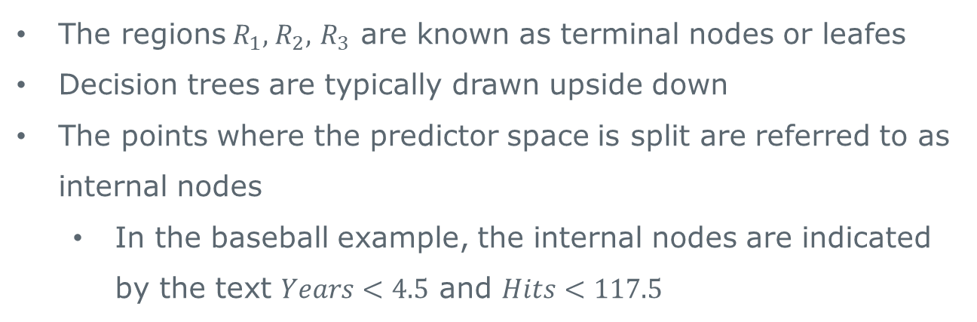
Tree terminology
The regions${ R}_{1},$ $R_{2},$ $R_{3}$ are known as terminal nodes or leafes
Decision trees are typically drawn upside down
The points where the predictor space is split are referred to as internal nodes
In the baseball example, the internal nodes are indicated by the text $Years<4.5$ and $Hits<117.5$

Slide 54
Interpretation
Years is the most important factor; players with less experience earn less
For less experienced players, the number of Hits in the previous year does not make a difference
But players who have been in the major leagues for five or more years, earn more when they hit more than 117.5 hits
While this might be an over-simplification, the interpretation is clear

Slide 55
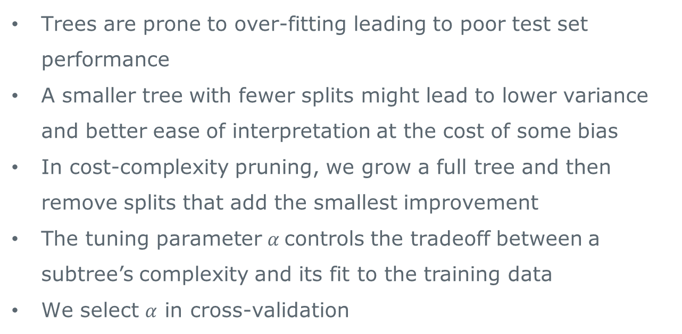
Pruning a tree
Trees are prone to over-fitting leading to poor test set performance
A smaller tree with fewer splits might lead to lower variance and better ease of interpretation at the cost of some bias
In cost-complexity pruning, we grow a full tree and then remove splits that add the smallest improvement
The tuning parameter $α$controls the tradeoff between a subtree’s complexity and its fit to the training data
We select $α$ in cross-validation

Slide 56
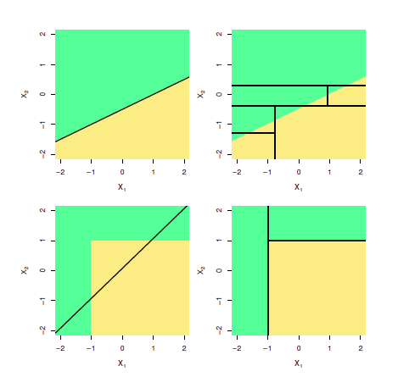
Trees v linear models
Hastie et al. 2008: 315
Top row: True linear boundary; bottom row: True non-linear boundary
Left column: linear model; right column: tree-based model

Slide 57
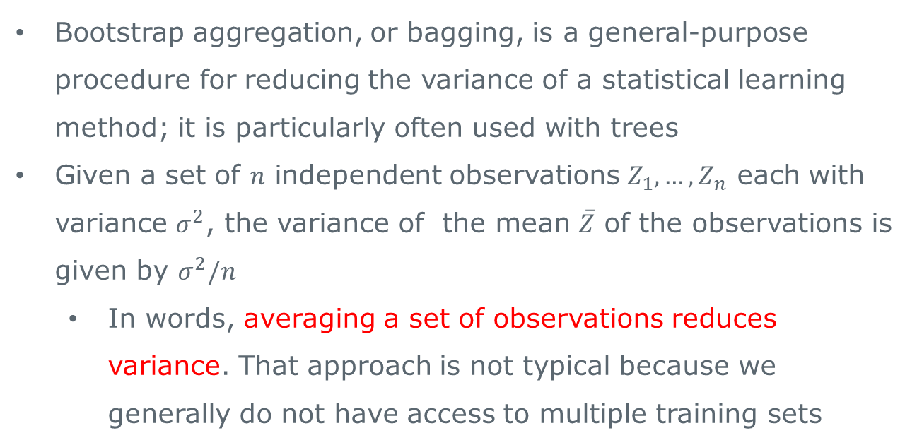
Bagging
Bootstrap aggregation, or bagging, is a general-purpose procedure for reducing the variance of a statistical learning method; it is particularly often used with trees
Given a set of $n$ independent observations $Z_{1},…, Z_{n}$ each with variance $σ^{2}$, the variance of the mean $\overline{Z}$ of the observations is given by $σ^{2}/n$
In words, averaging a set of observations reduces variance. That approach is not typical because we generally do not have access to multiple training sets

Slide 58
Bagging 2
Instead, we can bootstrap
Bootstrapping means repeatedly sampling from a sampling with replacement where the sample has the same size as the data it is sampled from (hence the need for sampling with replacement)
In this approach, we generate a large number of bootstrapped datasets and at fit a tree to each of them. Then we average over all the predictions

Slide 59
Out-of-bag (OOB) estimation
It turns out that we get the test error for free in bagging
Each tree uses on average 2/3 of the observations; the remaining 1/3 are the out-of-bag (OOB) observations
For any observation i, we can use the predictions from the trees in which that observations was OOB and then average over the predictions

Slide 60
Random Forests
Random forests (RF) is bagging with a small tweak that decorrelates trees and thereby reduces variance
In RF each time a split is made in a tree only a subset of the predictor space is considered for the split where the subset is chosen at random
The number of predictors to consider is a tuning parameter which we could pick using cross-validation
In practice, the number of predictors considered is usually the square root of the number of predictors

Slide 61
Boosting
Like bagging, boosting is a general approach
Boosting is similar to bagging except that trees are grown sequentially; each tree uses information from the previously grown trees (it is essentially grown on the residuals of the model)
Each new tree’s contribution is discounted by a learning rate
The learning rate is a tuning parameter, as is the number of trees to grow, and the number of splits in each tree
Essentially boosting is an ensemble of sparse trees

Slide 62



Thank you
Join in the conversation online:
@BLGDataResearch #Data2Life
LinkedIn: ESRC Business and Local Government Data Research Centre
YouTube: ESRC Business and Local Government Data Research Centre
Email: BLGDataResearch@essex.ac.uk

